Slide 1
Determination of Potential Localized Dust Sources and Sinks in Elysium Planitia, Mars
Janus Kozdon, C.S. Edwards
Physics and Astronomy Department,
Northern Arizona University

Slide 2
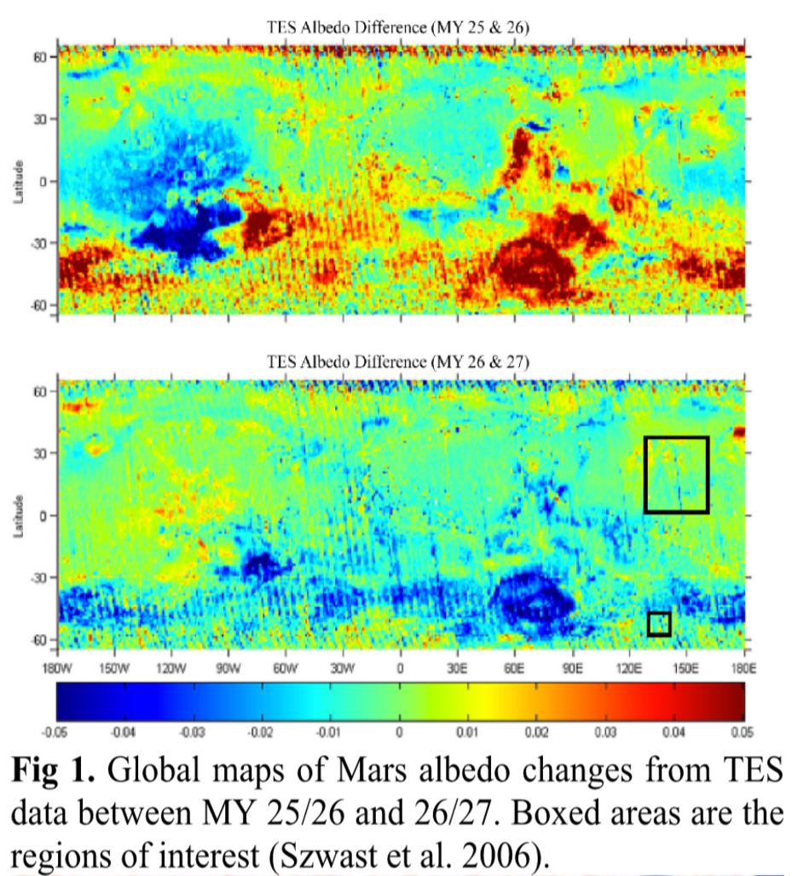
Introduction;
Thermal Emission Spectrometer (TES)
Surface differences are observed
Due to the dust cycle
Increase = more dust
Decrease = less dust

Slide 3
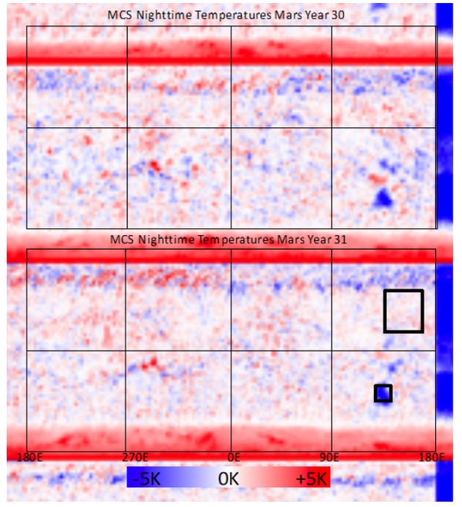
Introduction
Mars Climate Sounder (MCS)
Temperature Changes
Higher = less dust
Lower = more dust
Fig 2. Global maps of Mars nighttime temperature from MCS data between MY 30 and 31. Temperature differences from the median 3AM temperatures are shown.

Slide 4
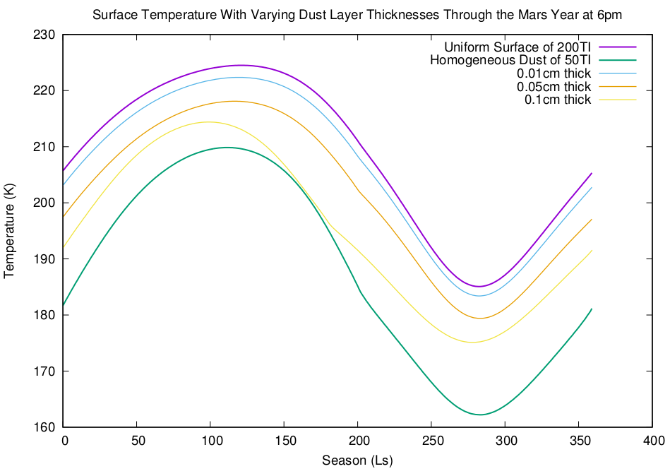
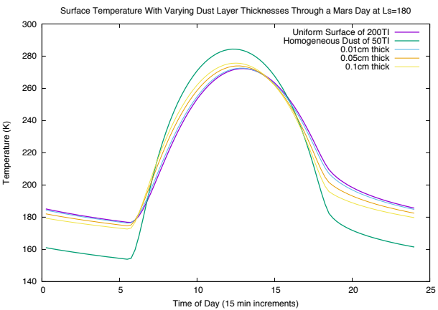
Does dust have an Effect?
0.01cm thick of dust can cause ~1-2K difference
It does have a considerable effect
Temperature differences can be correlated to differential dust thicknesses
Fig 3. (top)
Plot illustrating the effects of homogeneous dust (50TI) layers over a uniform Mars surface (200TI) over the course of a Mars year.
Fig 4. (bottom)
Plot illustrating the effect of homogeneous dust (50TI) layers over a uniform Mars surface (200TI) over the course of a Mars day

Slide 5
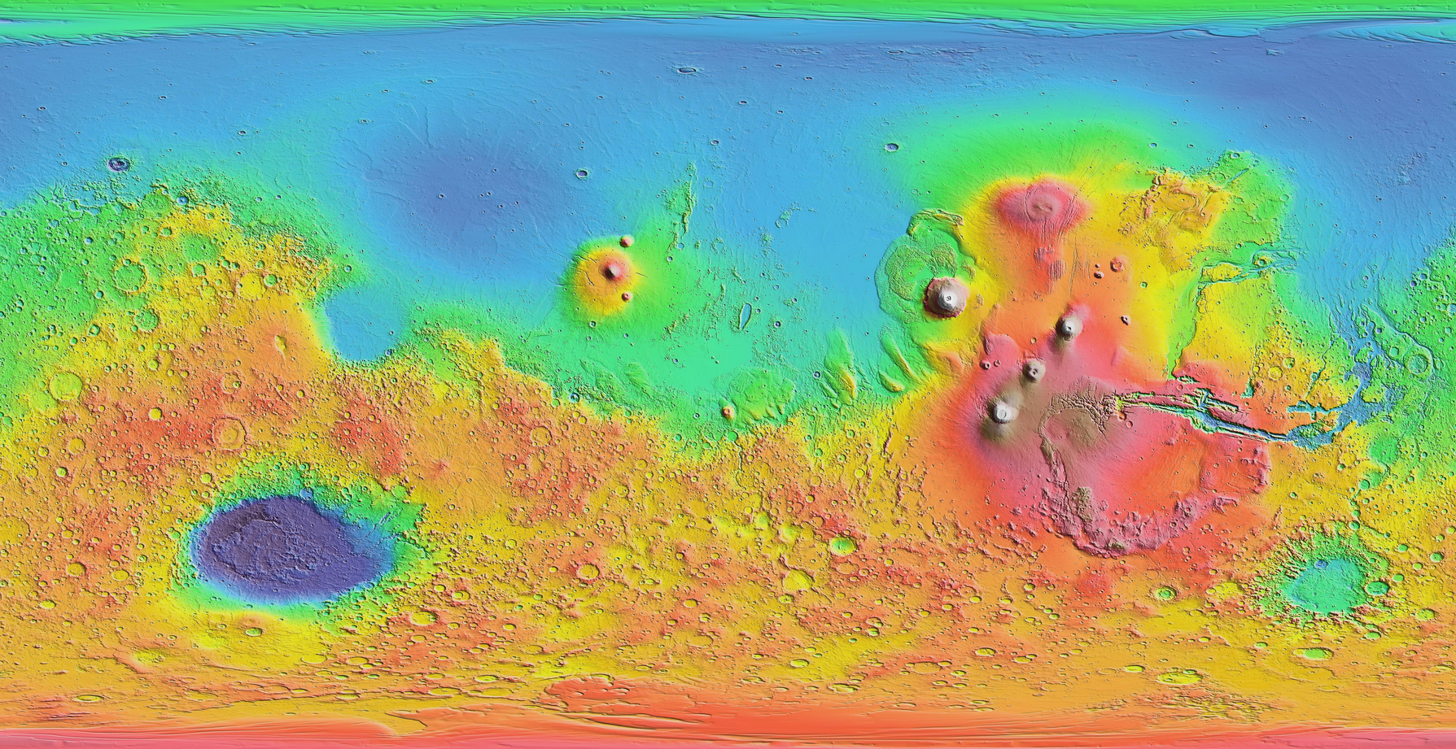
Geologic context
Mars Orbiter Laser Altimeter (MOLA)
https://marsoweb.nas.nasa.gov/globalData/images/thumbnails/MOLA_cylin.jpg

Slide 6

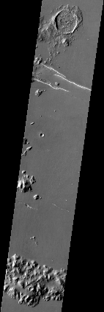
Methods
THEMIS Standard Processing
Undrift
Dewobble
Rtilt
Deplaid
Destreak
Temperature Conversion

Slide 7
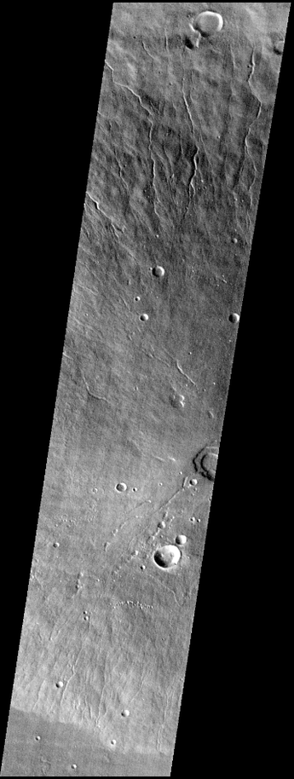
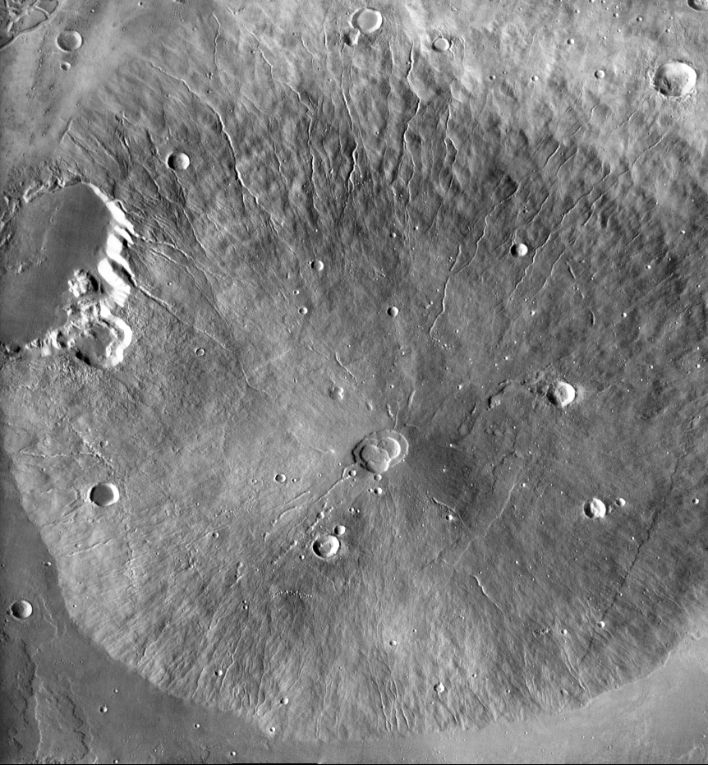
Methods
Co-Registering
Images are given the same background reference frame for comparison accuracy

Slide 8
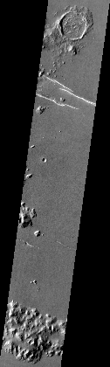
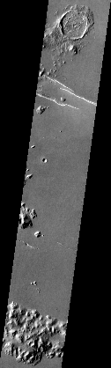
Methods
Normalization
Same average
Same standard deviation
Image 1
MY= 30
Ls= 85.7
Local time= 16.6 hr
min: 192.0
max: 251.0
avg: 222.9
stddev: 5.17
sum: 197537508.1
Image 2
MY= 26
Ls= 95.9
Local time= 16.1 hr
min: 194.1
max: 247.3
avg: 222.9
stddev: 5.17
sum: 197537508.1

Slide 9
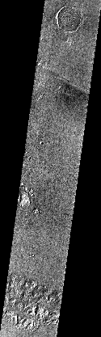
Results
Image1 - Image2 =
Difference Image
This is strictly what changed in the timeframe between images
Difference Image
min: -14.2
max: 12.4
avg: 2.21e-09
stddev: 1.14
sum: 0.001907348633

Slide 10
Results
Image1 - Image2 =
Difference Image
This is strictly what changed in the timeframe between images
-3.511123657 K
Difference Image
min: -14.2
max: 12.4
avg: 2.21e-09
stddev: 1.14
sum: 0.001907348633

Slide 11
Going Forward
Temperature differences to dust thicknesses conversions
Continual analysis over the same area of interest will help determine the location’s contribution to the dust cycle
Temperature vs. Time plots
Pair analysis for global coverage

Slide 12
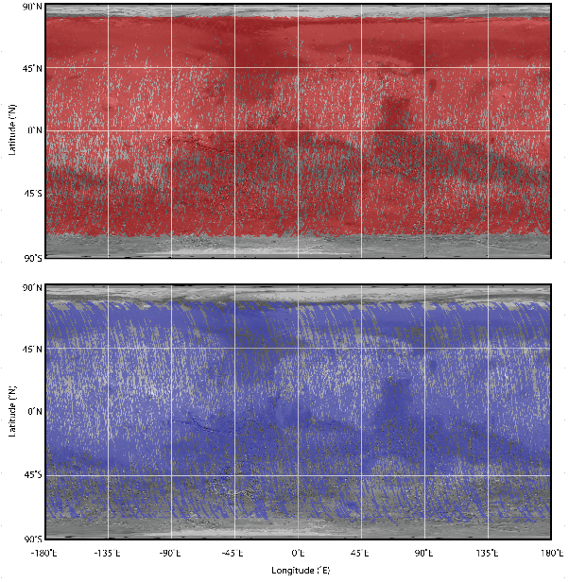
Image Pairs
Overlapping sections of THEMIS daytime (top) and nighttime (bottom) image pairs acquired within 1 hour local time and 20˚Ls of one another. Furthermore they have have a minimum of 100km2 overlap. Images acquired the same MY were eliminated.

Slide 13




acknowledgements
The Northern Arizona University Hooper Undergraduate Research Award
The Northern Arizona University NASA Space Grant program
The NASA Mars Data Analysis Program
Szwast, M. A., M. I. Richardson, and A. R. Vasavada (2006), Journal of Geophysical Research, 111(E11).

